Slide 1
Module 5.1 – Dead Reckoning
Introduction to Dead Reckoning

Slide 2
Dead Reckoning
Estimates a position based on the change from a previous position
Does not require maps or outside references
Utilizes sensor data and the precise physical measurement of the robot
Notes:
Dead reckoning is a way for a robot to estimate its position using only sensors that are available on the robot
Other techniques for determining a robot’s location require maps or external references like GPS or signal strength
Dead reckoning is useful because it can be performed even when the robot is in unfamiliar territory and is unable to communicate.
In order to successfully estimate a position, the robot can use its sensors to estimate how far it has traveled.
The physical dimensions of the robot, the size of its wheels, and the layout of the wheels is important for dead reckoning algorithms.

Slide 3
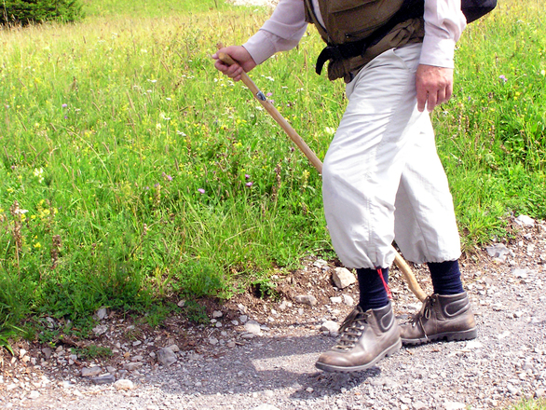
Humans and Dead Reckoning
Humans can estimate their position by counting their steps and multiplying by the size of each step
Most people, however, estimate their distance traveled based on how long they have been walking and how fast they typically walk
Notes:
When a detailed map is not available, humans typically rely on dead reckoning to estimate how close they are to their goal.
However, humans often struggle with estimating their direction in the absence of external cues.
When people give directions, they often explain the path in terms of a dead reckoning system. For example:
“Go five minutes down the road”
“Turn right then take ten steps”

Slide 4
Robots and Dead Reckoning
For precise positioning, GPS and other external localization aides can be insufficient
Additionally many robots operate in areas where there are limited environmental cues to aid in positioning
Dead reckoning is a technique that is employed by robots in these scenarios.
Notes:
Traditional GPS is typically accurate to only several meters. Robots that need to more accurately position themselves must then estimate their position with dead reckoning to achieve a more precise estimate than is possible with GPS alone.
Underwater robots often have limited access to environmental markers or communication with other entities, so they must be able to estimate their position using only the sensors available onboard.
Aerial robots are susceptible to gusts of wind that can change their position; a good dead reckoning system can help correct from these issues by constantly tracking the movement of the robot
Ground robots may be unable to connect to large sensor networks (like GPS) when they are in remote areas (caves, forests, Mars, etc). In these cases dead reckoning is essential for the robot to continue moving while knowing where it is located

Slide 5
When to Use Dead Reckoning
When external references are noisy or imprecise
When positioning systems (GPS) are unavailable or unreliable
Notes:
Dead reckoning is an important tool that can be used in conjunction with other techniques that incorporate environmental inputs
If a robot is in a cave or building then it may not be able to receive GPS or other signals to help find its location; in these situations dead reckoning is essential.
In highly uniform environments (like underwater or in space), the robot may not be able to identify references so it cannot track its movement against another object; these situations also require dead reckoning for determining the robot’s position.

Slide 6
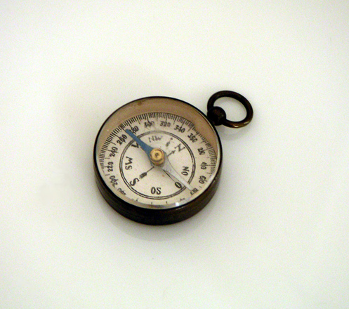
Important Sensors
Accelerometer
Gyroscope
Compass
Motor Encoders
Notes:
Many different sensors can be used to aid in dead reckoning.
Simple dead reckoning systems do not use any sensors but rather estimate movement based on the commands sent to the motors.
The acceleration measured by an accelerometer can be integrated with respect to time in order to establish robot velocity
A gyroscope can be used to detect and calculate changes in the robot’s direction
A robot can determine its direction using a compass (although this is typically limited to direction in only two axis)
Motor encoders track how far the wheels have rotated, which can be used to estimate the robot’s displacement

Slide 7

Basic Dead Reckoning
xt is the position of the robot at the current time
x0 is the position of the robot at the previous step
v is the velocity of the robot
t is the duration between updates
Notes:
Dead reckoning defines the current position as the previous position plus velocity times the duration of time.
Unfortunately, neither Xo nor V are possible to know exactly. Rather the system must predict the previous position and velocity
The more accurately the robot knows its previous position and velocity, the more accurately it can estimate its current position.

Slide 8

Probabilistic Dead Reckoning
Since the previous position and velocity are not known precisely, they are often expressed as random variables
Probability can be used to define the uncertainty of these measurements.
Notes:
As more updates to the robot’s position are made, the degree of certainty in the robot’s location decreases
Random variables allow us to specify the certainty of the location predictions

Slide 9
Cumulative Errors
Center of each circle is the prediction position at each time step
Size of the circle depicts the uncertainty of the prediction
As the robot continues to move, the uncertainty increases
Notes:
The diagram clearly shows the reality of dead reckoning.
The robot cannot perfectly estimate its velocity so each time it updates it position it increases its uncertainty
In future lessons, we will examine ways of mitigating this increasing uncertainty
Fine-tuning the sensors used to estimate the velocity of the robot can significantly reduce the uncertainty, although it will not eliminate it

Slide 10
The GPU Teaching Kit is licensed by NVIDIA and California Polytechnic State University under the Creative Commons Attribution-NonCommercial 4.0 International License.

